Slide 1

JAWAHARLAL NEHRU TECHNOLOGICAL UNIVERSITY HYDERABAD UNIVERSITY COLLEGE OF ENGINEERING MANTHANI Centenary Colony(Po), Pannur(Vill), Ramagiri(Mdl), Peddapalli, Telangana – 505212, India
DEPARTMENT OF COMPUTER SCIENCE AND ENGINEERING(AI&ML)
EMPOWERING FARMERS THROUGH PRICE COMPARISION AND COLLABRATION
Under the guidance of:
Mr.G.SRIDHAR
Assistant Professor,CSE
TEAM MEMBERS:
M.YASHWANTH 22VD1A6656
D.AKHIL 22VD1A6604
B.SAI SIDDARTHA 22VD1A6635

Slide 2
contents
INTRODUCTION
PROBLEM STATEMENT
EXISTING SYSTEM
PROPOSED SOLUTION
SOFTWARE REQUIREMENT SPECIFICATION
SYSTEM DESIGN
IMPLEMENTATION
CONCLUSION

Slide 3
INTRODUCTION
Empowering farmers through price comparison and collaboration means giving them the tools and resources to be successful in the online marketplace. Here are breakdowns:
Price Comparison Tool: Shows farmers the best prices for their crops across different online marketplaces.
Collaboration Features: Helps farmers connect, pool harvests, and negotiate better deals, increasing market reach and bargaining power.
Overall Empowerment:
Make informed decisions about where to sell their crops.
Increase their bargaining power and potentially secure better deals.
Access wider markets that might have been inaccessible individually.
Gain greater control over their online sales strategy.

Slide 4
PROBLEM STATEMENT
The agricultural industry is the backbone of our food system, yet farmers often struggle to receive fair compensation for their efforts.
Prices can be volatile, leaving them vulnerable to exploitation by middlemen. This introduces an imbalance of power that hinders their ability to earn a sustainable living.
This is where innovative solutions come in. By utilizing price comparison tools and fostering collaboration, we can empower farmers to take control of their livelihoods.
Let's delve into how these strategies can revolutionize the agricultural landscape.

Slide 5
EXISTING SYSTEMS
1. Market Information Systems (MIS)
Agri Market Mobile App: Real-time price info, news, advisories for informed selling decisions.
Commodity Exchange Platforms: E.g., NCDEX in India; transparent pricing and trading opportunities.
2. Price Comparison Tools
Digital Platforms: Compare prices from various buyers/markets for best selling opportunities.

Slide 6
Proposed solution
Real-time market data: Farmers access up-to-date information on prices offered by various buyers in their region. Mobile apps or online platforms aggregate this data, providing transparency and eliminating information asymmetry.
Historical price trends: These tools analyze past data to help farmers predict future market fluctuations. This allows them to plan strategically, deciding when to sell their crops to maximize profits.
Collaboration platforms connect farmers to form collectives. They can then:
Negotiate better prices with buyers due to increased volume.
Buy supplies in bulk for lower costs.
Share knowledge and best practices.

Slide 7
Software requirements specification
HARDWARE REQUIREMENTS | SOFTWARE REQUIREMENTS
Memory - At least 4GB | Operating System – Windows 11
Storage – 512GB | HTML,JAVASCRIPT,PHP
Processor – 11th Gen Interl® Core™ i5 | XAMPP,HOSTINGER SITE,SMTP

Slide 8
SYSTEM DESIGN
FARMERS
HOMEPAGE
NONFARMER
Select the region.
Collect the data &enters the prices of products at different platforms
Type of product you want to sell
Quantity of the product
YES
Want sell in collab
Select partner OWN
NO
NO
end
Take suggestion from website
Display price according to the crop quality at different platforms
Partner selected

Slide 9
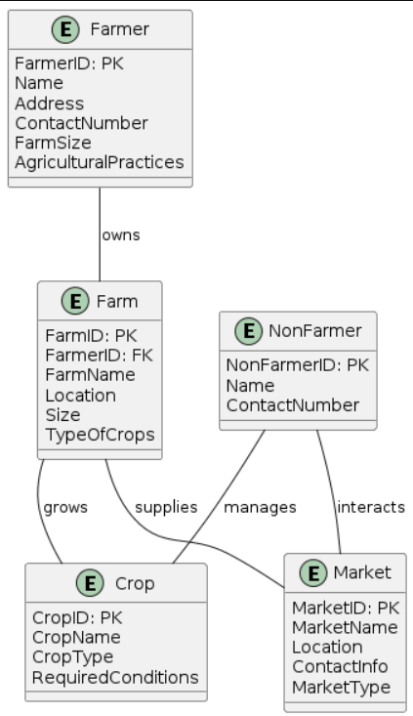
.
CLASS DIAGRAM

Slide 10
IMPLEMENTATION
Users allowed to interact with interface created using HTML,CSS,JS.
User continues further process by choosing login accordingly and details stored every time.
By entering as non-farmer he enables to enter the different crop price at different platforms.
By entering as farmer he enable to collaborate with other farmers or without collaboration he used to get the details of choosen crop at different platforms.
The end feedback will be entered accordingly.

Slide 11
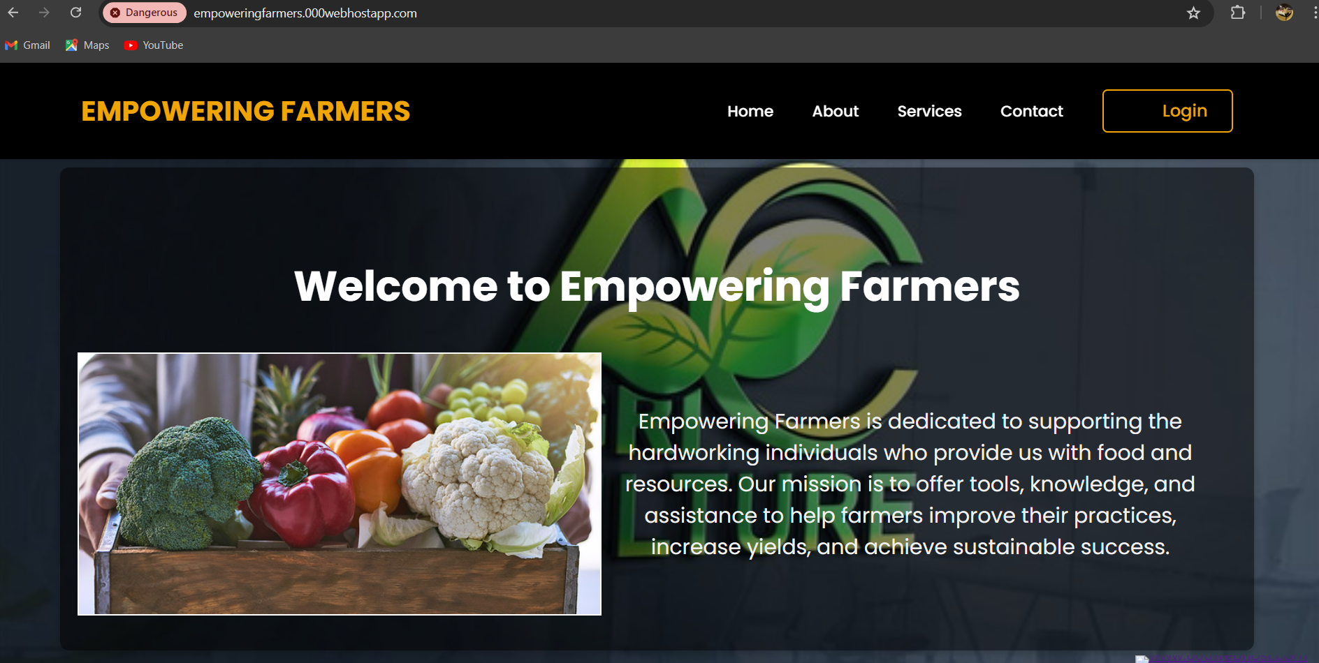
INTERFACE:

Slide 12
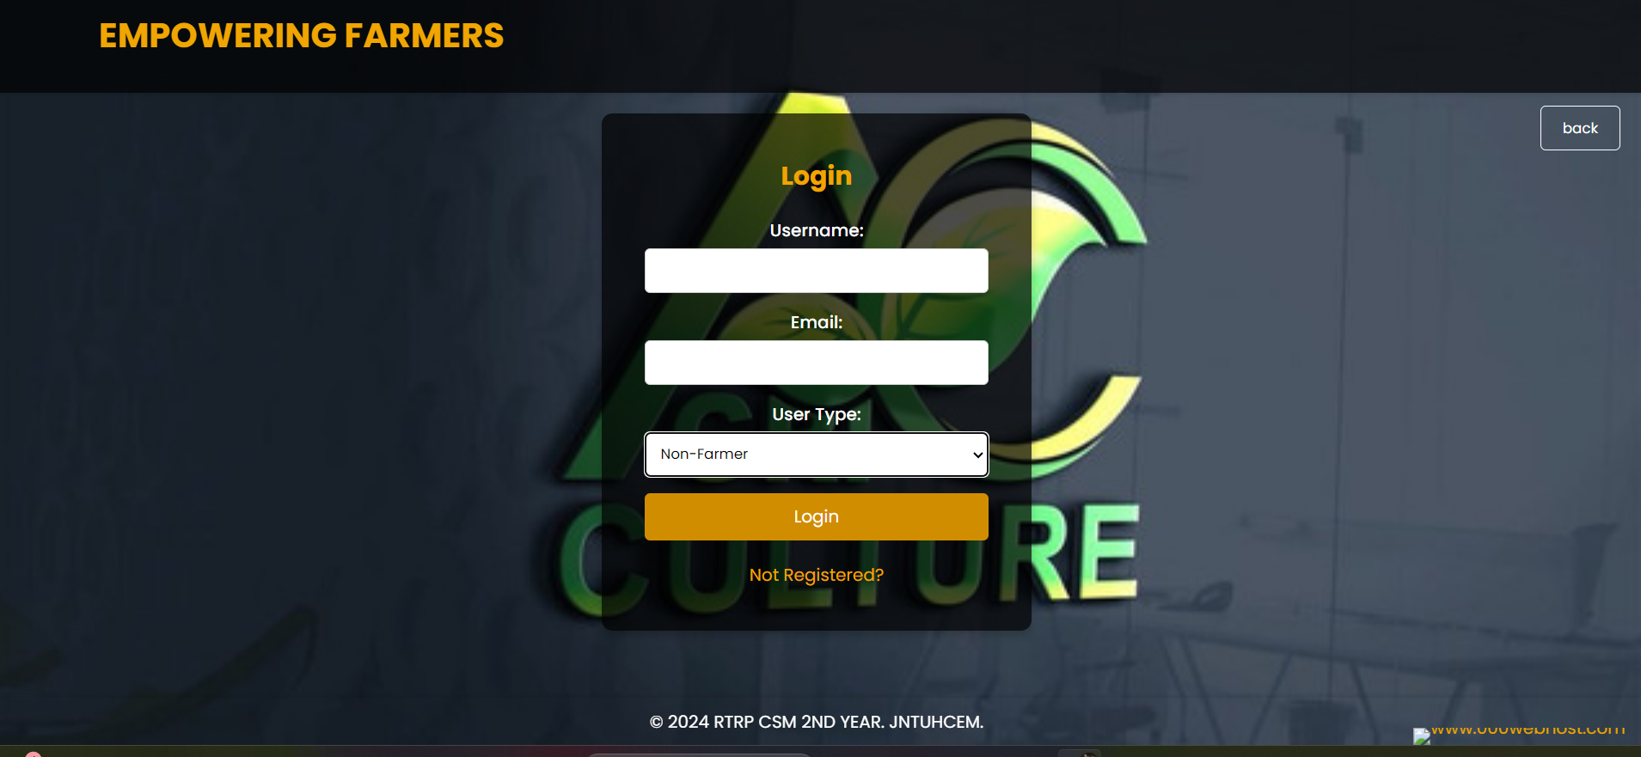

Slide 13
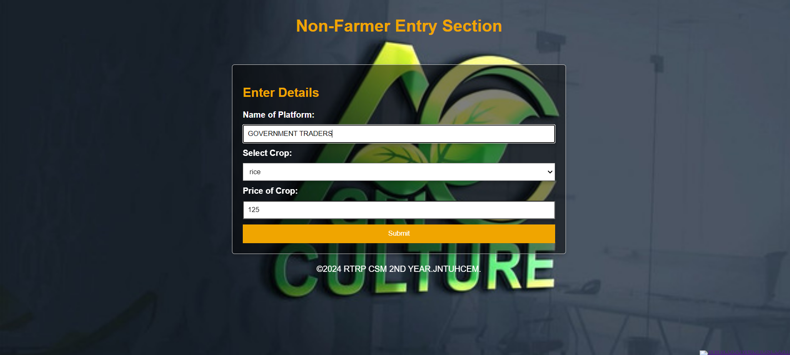

Slide 14
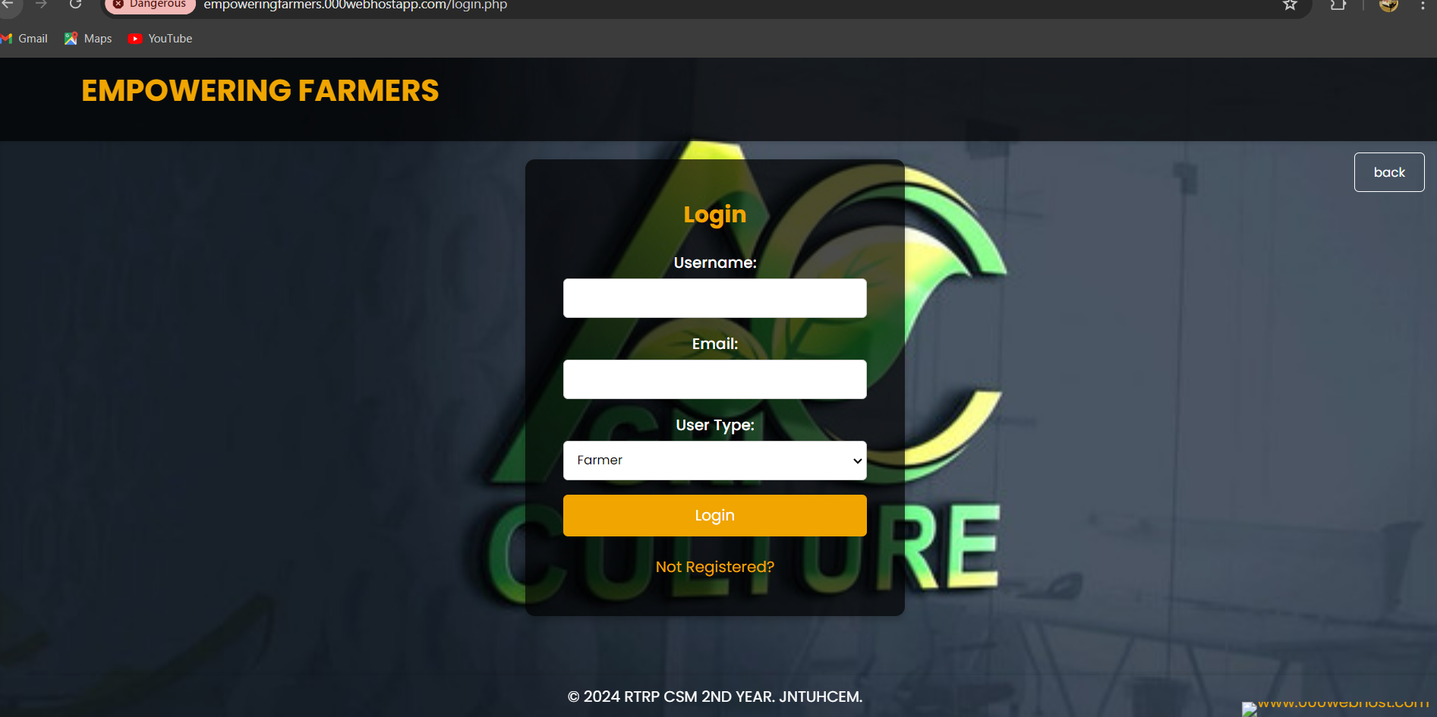
LOGIN:

Slide 15
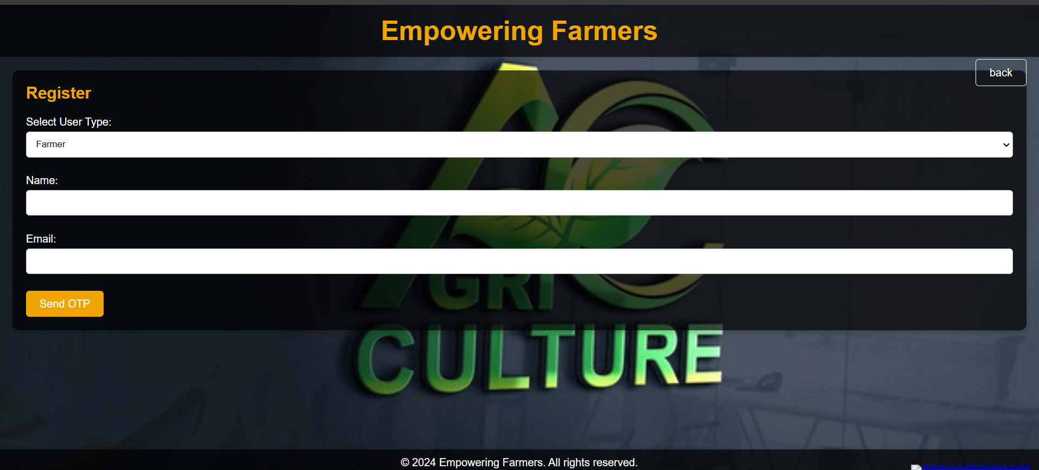

Slide 16


Slide 17
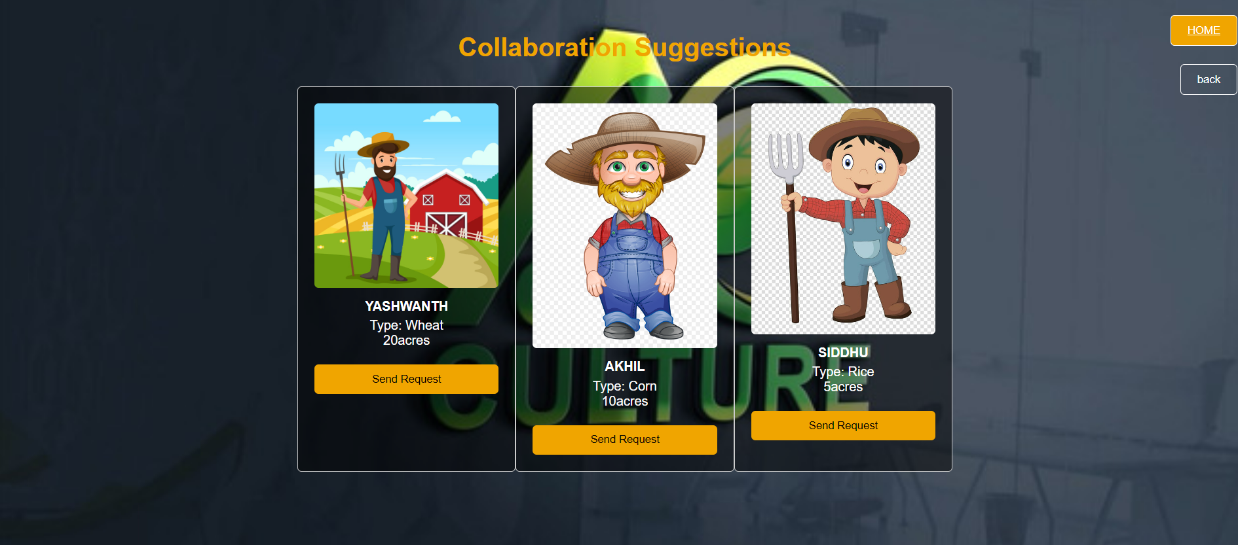

Slide 18


Slide 19


Slide 20
CONCLUSION
TRANSFORMING AGRICULTURAL LANDSCAPE
By empowering farmers through price comparison and collaboration platform ,we aim to transform agricultural landscape. By providing transparency, collaborative approach ,we believe we can create more equitable and prosperous future for farmers and they serve.
The result? A stronger, fairer, and more sustainable food system for all.

Slide 21
THANK YOU!

Slide 22
ANY QUERIES?

